Slide 1

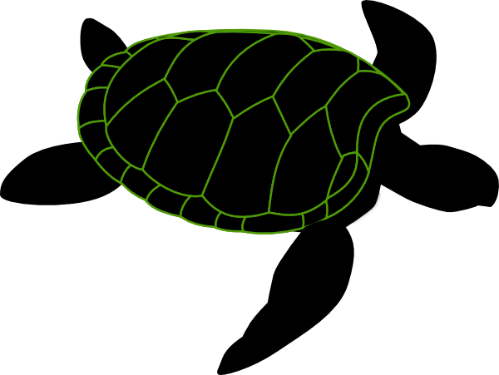
TurtleTech Sprint 1 Embry Riddle Aeronautical University Senior Design – Spring 2023
By: ROSEELLEN HOKE, Laurel Dodson, Parker Brown, Christopher Angland

Slide 2

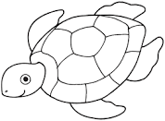
Vision
Our goal is to maintain functionality of the neural network software and hardware payload, while creating a framework and instructions to transition the payload between several UAVs to increase the ease of deployment of the system.
Notes:
Parker
Our vision is to help improve the TurtleTech operations crew deployment capabilities by making the payload more swappable between various UAVs. TurtleTech is an unmanned aircraft created by Northrop Grumman and partnered with the Brevard Zoo to help conserve and educate the world on Florida's turtle population. The UAV currently flies within line-of sight capturing images, and uses a neural network on a Nvidia Jetson device to identify turtles from an aerial view. As the Embry Riddle TurtleTech team,

Slide 3
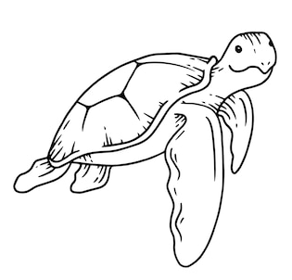
Retrospective & Goals
Switched the focus of group from software to more hardware
The goal is to make the payload more adaptable for additional UAVs in future missions
Adding electrical infrastructure to make payload easier to use for pilots
Creating documentation to streamline the process of getting started on working on the AI for future groups
Notes:
RoseEllen

Slide 4
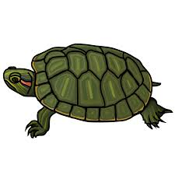
Sprint Outlook
1
2
3
Get everyone on the same page
Create documentation on how to start up the Jetson Nano
Learn inventor and start brainstorming ideas on Jetson casing
Design a prototype Jetson casing for the payload
Create tutorial video on how to power on the Jetson
Support Alejandro on taking of the AI at flights
3D print Jetson nano casing
Continue support on AI payload
Test casing for durability and practicality
Notes:
RoseEllen

Slide 5
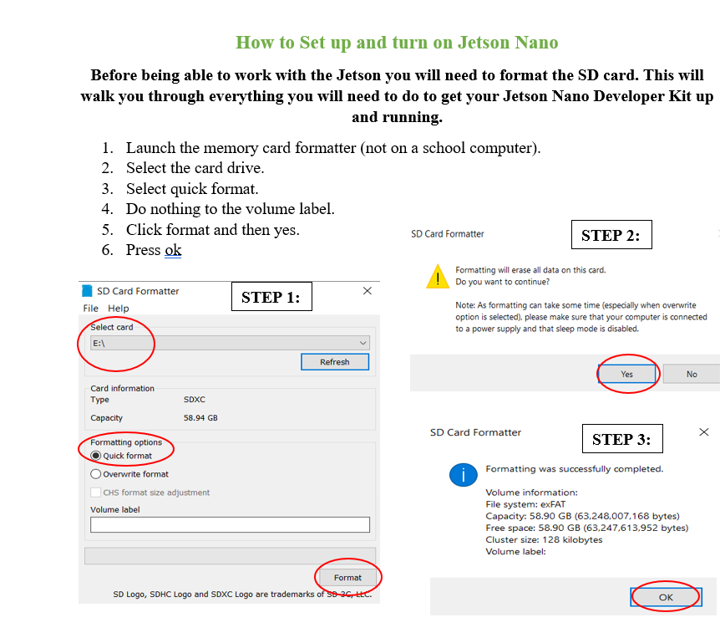
Accomplishments this Sprint
Created documentation on how to start up the Jetson Nano
Started using inventor to design frameworks to make the payload more mobile
Notes:
RoseEllen

Slide 6
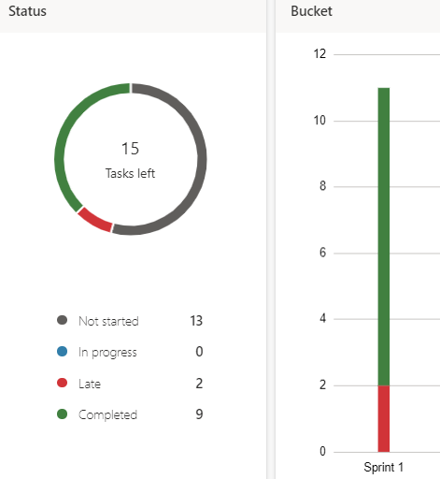
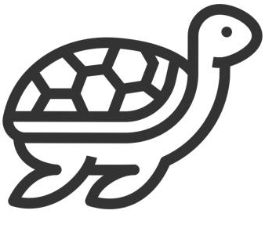
Burndown Chart

Slide 7
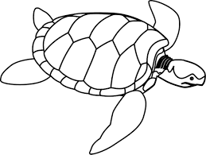
Aspects of System Design
General Constraints
The framework we design contains all necessary payload components
Design Considerations
The current Censys payload bay has specific manufacture standards for the payload bay, meaning modifications from the original casing are limited
The framework must be able to be design on the available tools, and must fall within the limits of our manufacturing methods (Fused Deposition Modeling)
Thus, the design must be pratical and comply with manufacture standards
Notes:
Laurel

Slide 8
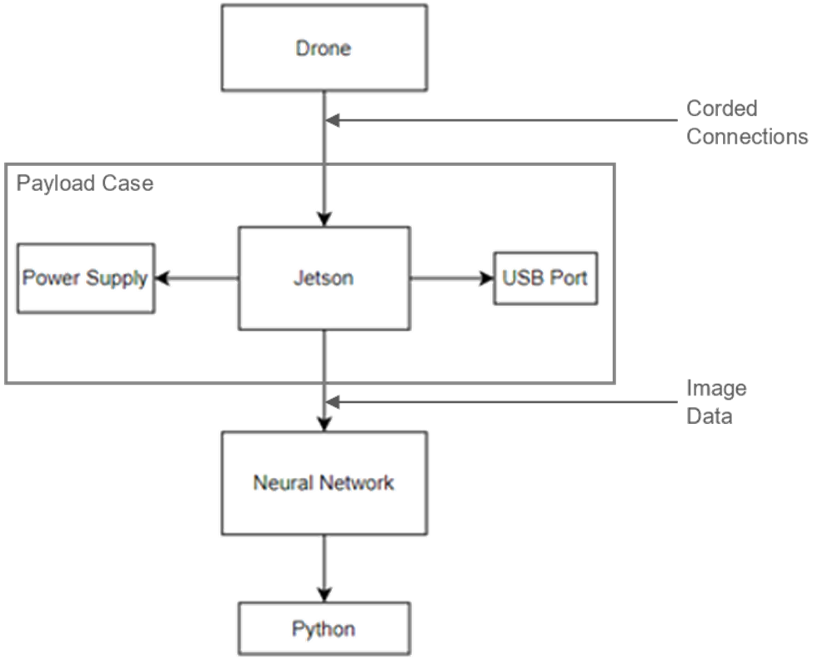
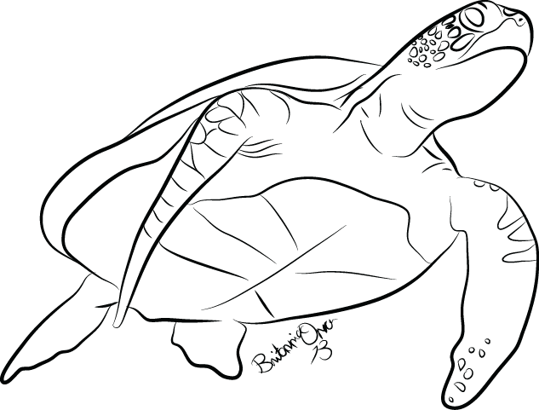
System Architecture
The system is outlined in our new Jetson Directives, and power/data transfer remains the same.
The payload case will ease access to external connections, making transfer of the Jetson into the UAV chassis more streamlined.
Notes:
Laurel

Slide 9
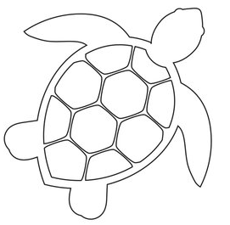
Subsystems Overview
Jetson Directives
Optimize the deployment time of the Jetson system for current and future flights.
Payload Swap Framework
We intend to speed the transition of the software payload into UAVs for flight testing.
Notes:
Laurel
To do so, we are forming an instruction set to simplify starting and running the Jetson for flight tests.
To do so, we are designing a standard holding case for moving the Jetson between UAVs.

Slide 10
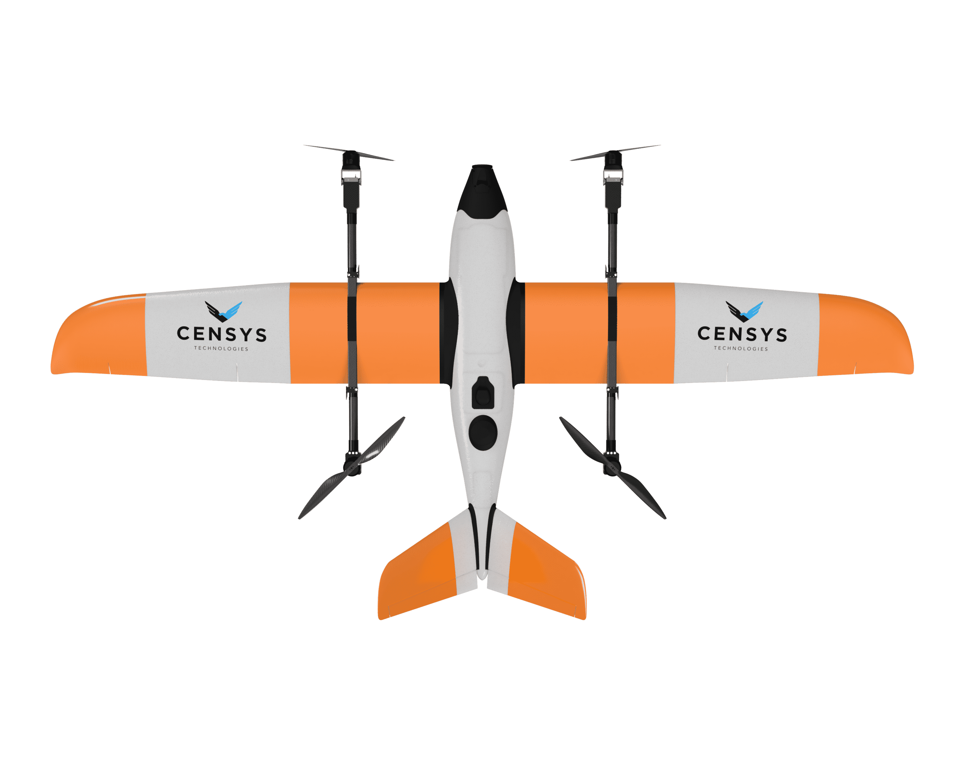
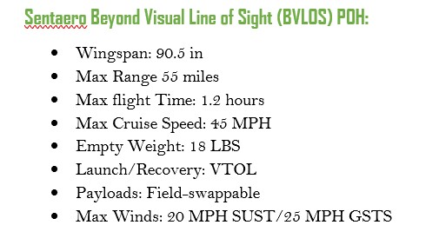
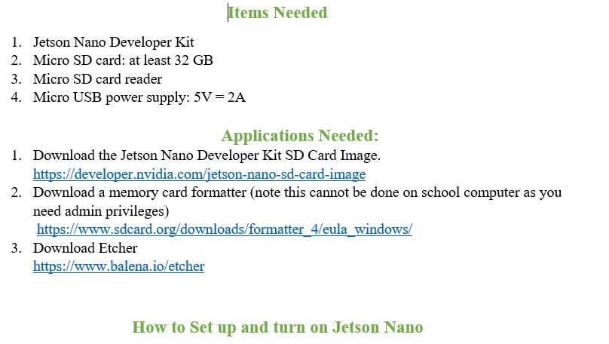
Subsystem Jetson Directives
Sentaero POH
Jetson Nano Tutorial
Notes:
RoseEllen

Slide 11
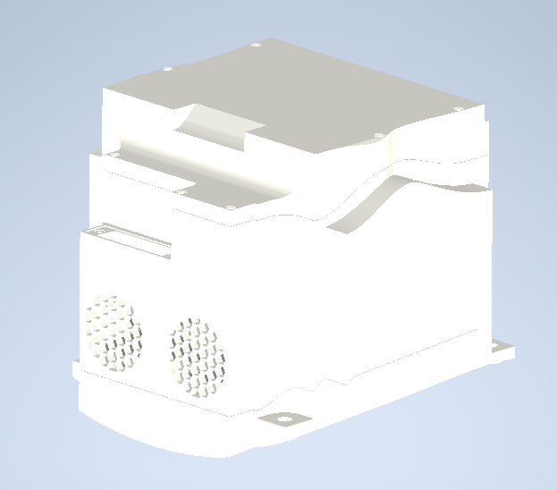
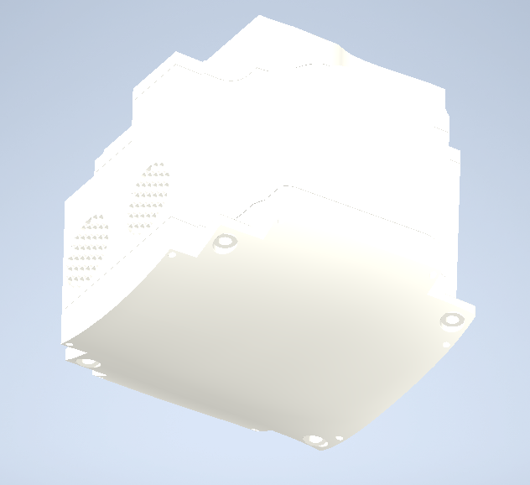
Subsystem Payload Swap Framework
For rapid transition of the payload into UAVs, we need a containment unit or case
We've brainstormed some 3D models for this case
Our team is learning Inventor to design those models for manufacturing
Notes:
Parker

Slide 12
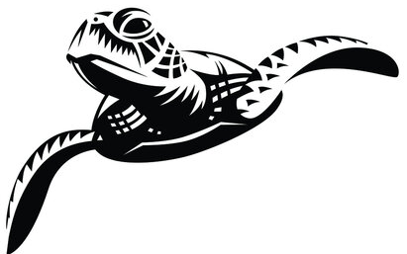
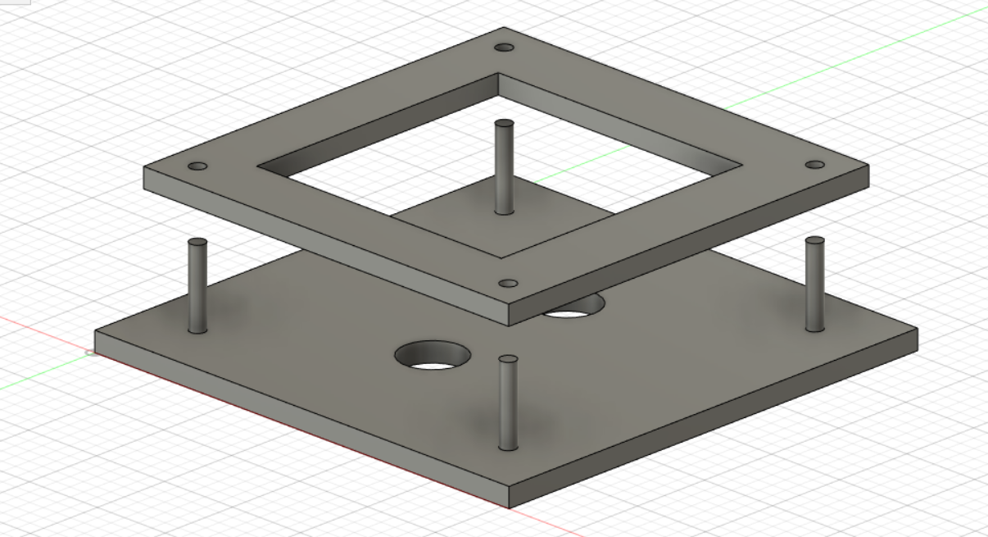
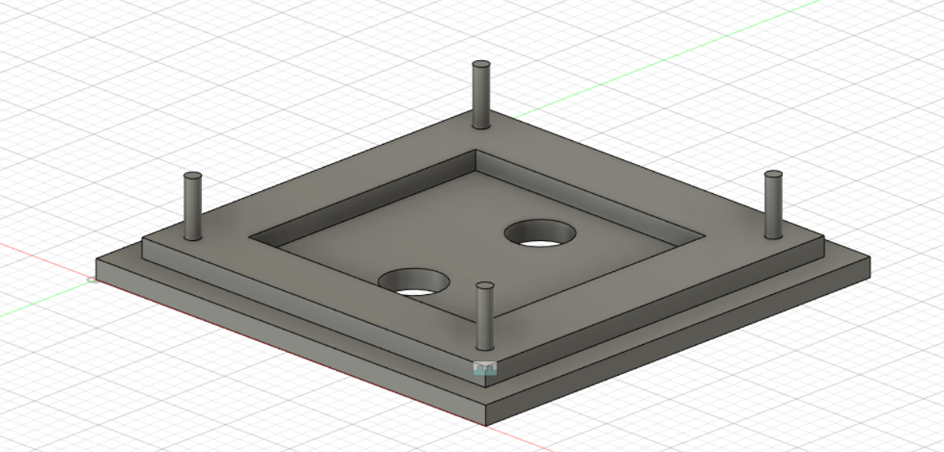
Mounting Concept 1
Notes:
Parker

Slide 13
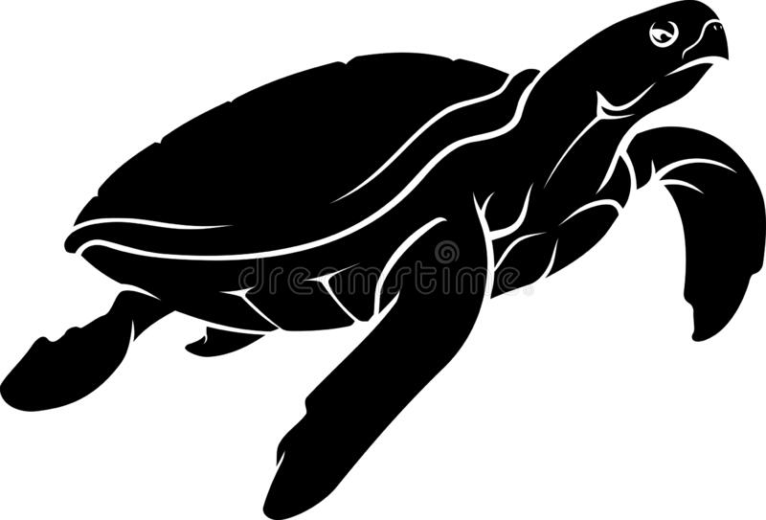
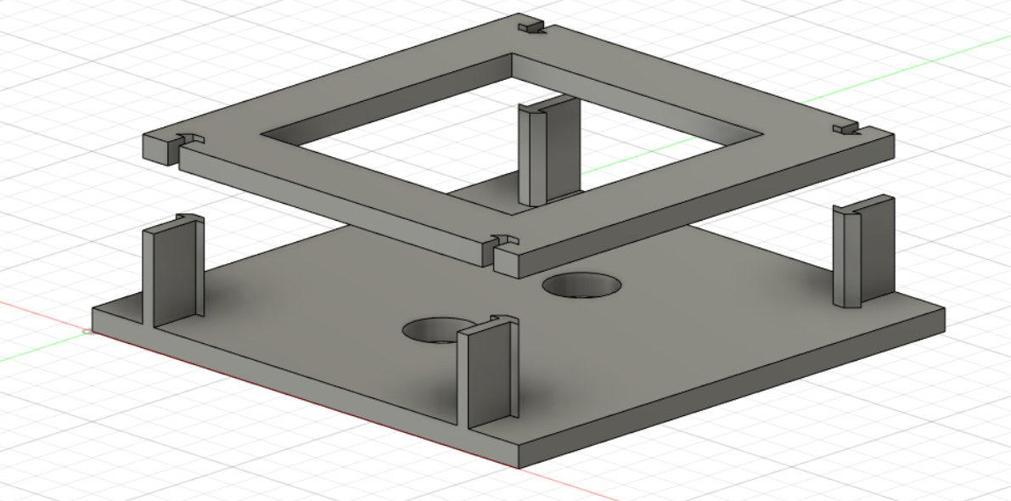
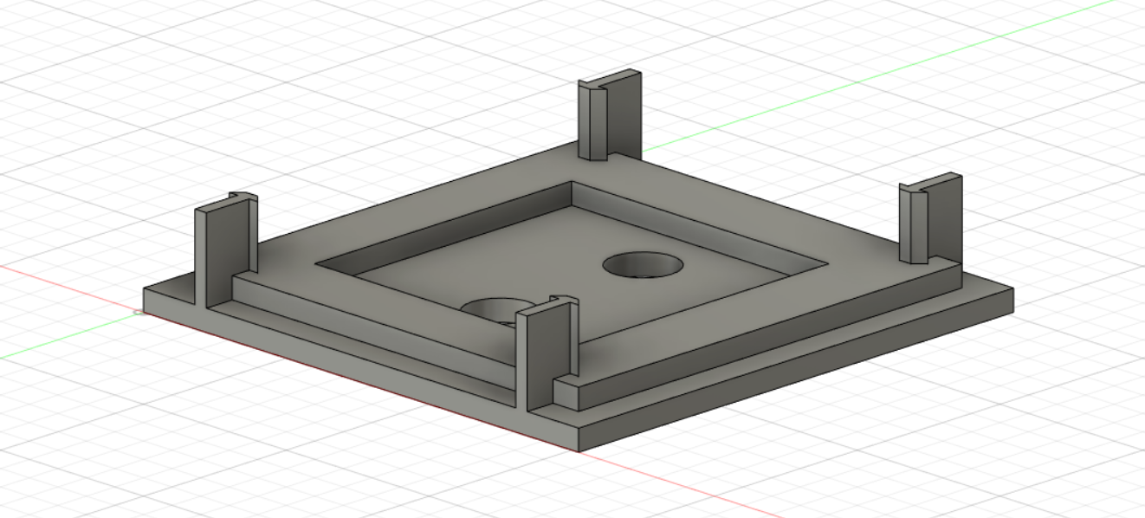
Mounting Concept 2
Notes:
Parker

Slide 14
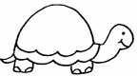
Interface & Exports
Current design set is run on Windows machines
Instruction set will assist in starting up software/hardware on the Jetson
Exports will be functional to run on the Jetson that can be operated on multiple UAVs
Notes:
Chris

Slide 15
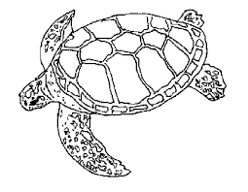
Lessons Learned
Hardware restrictions to run design software
Limitations of resources available on Jetson hardware
Reaching out to knowledgeable sources for information about standard operations
Notes:
Chris

Slide 16
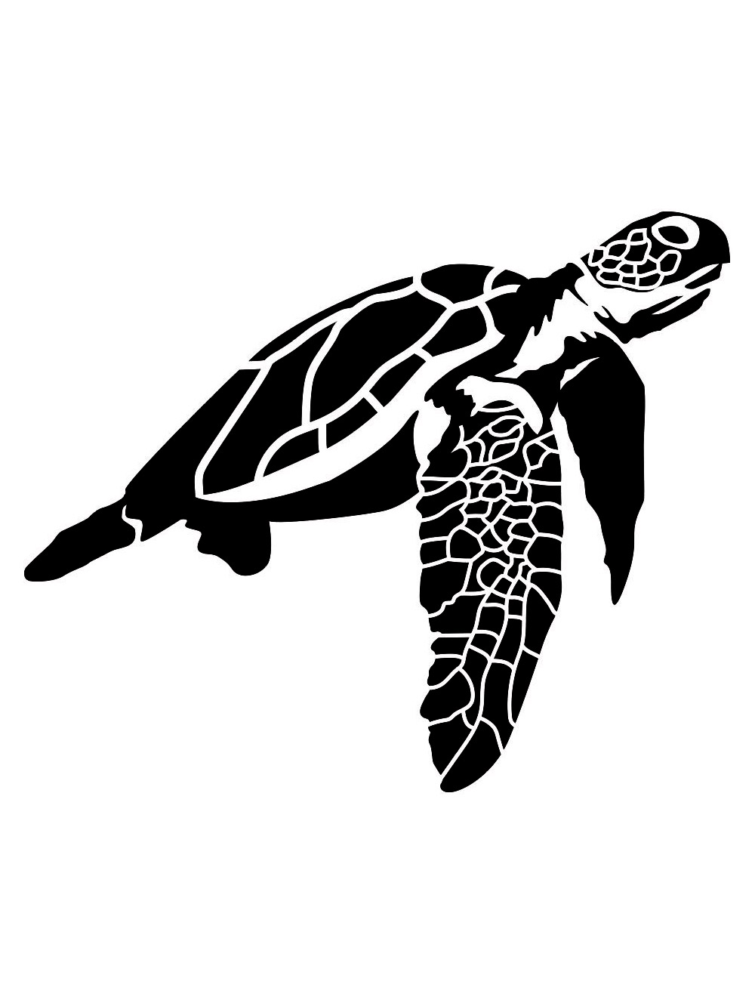
Next Steps
Tutorial
Video
1
Design a prototype model of the Jetson case
2
Attend a flight to shadow Alejandro
3
Notes:
Chris

Slide 17
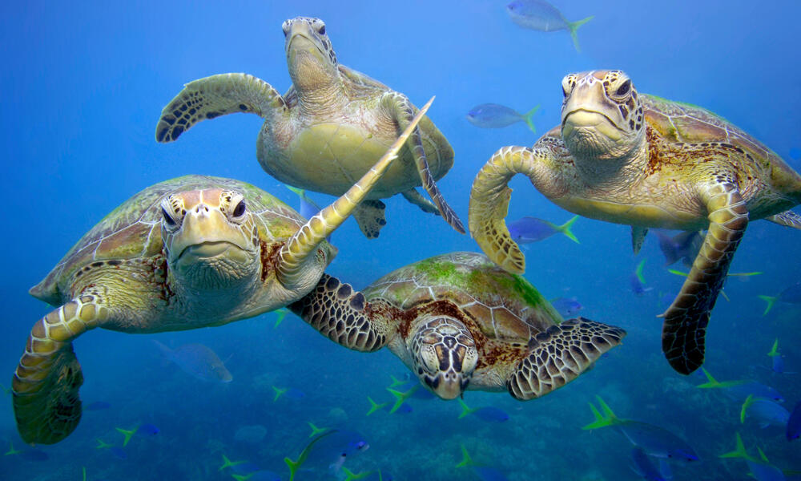
QUESTIONS?
Notes:
Chris

